Slide 1

Farm Monitor User Manual
JULY 2024
Implemented by ELEVATE Ltd.
Funded by the Bureau of International Labor Affairs, USDOL IL358082075K

Slide 2
Table of contents
Introduction to the platform
Farm SAQ
Creating your account and completing onboarding (Profile)
Home Screen
Requests
Respond to Request
Community Risk Scan
Side Menu – Edit Profile, Log out, User Management, Delete own account
Forgot Password

Slide 3

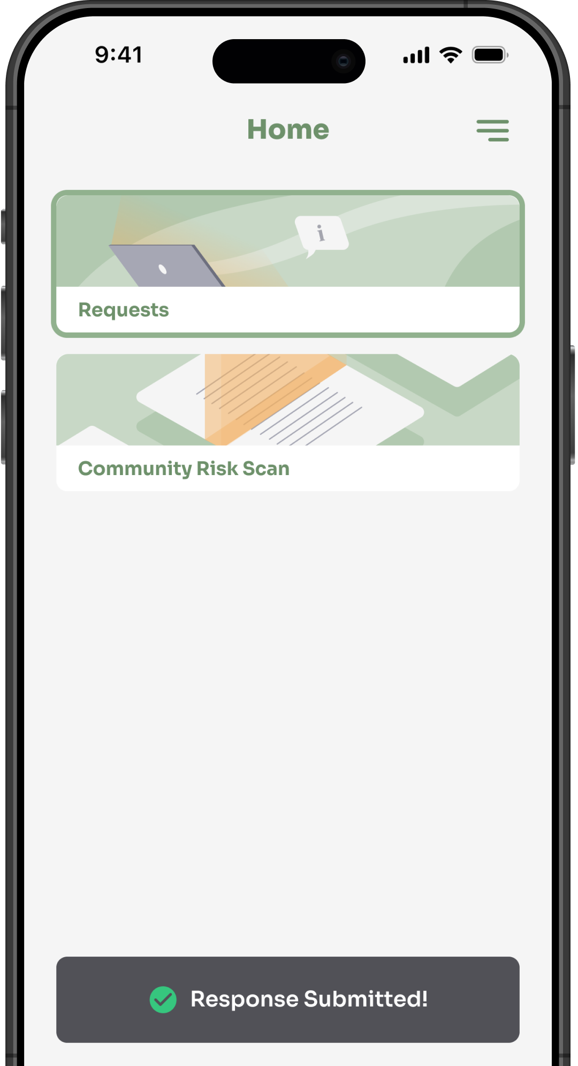
Introduction to the platform
Application can be accessed from the below URL
https://globaltrace.uat.dgnx.io/
Mobile application can be downloaded from Google Play Store and the App Store
AppStore Download:
[AppStore Link]
Play Store Download:
[Play Store Link]

Slide 4
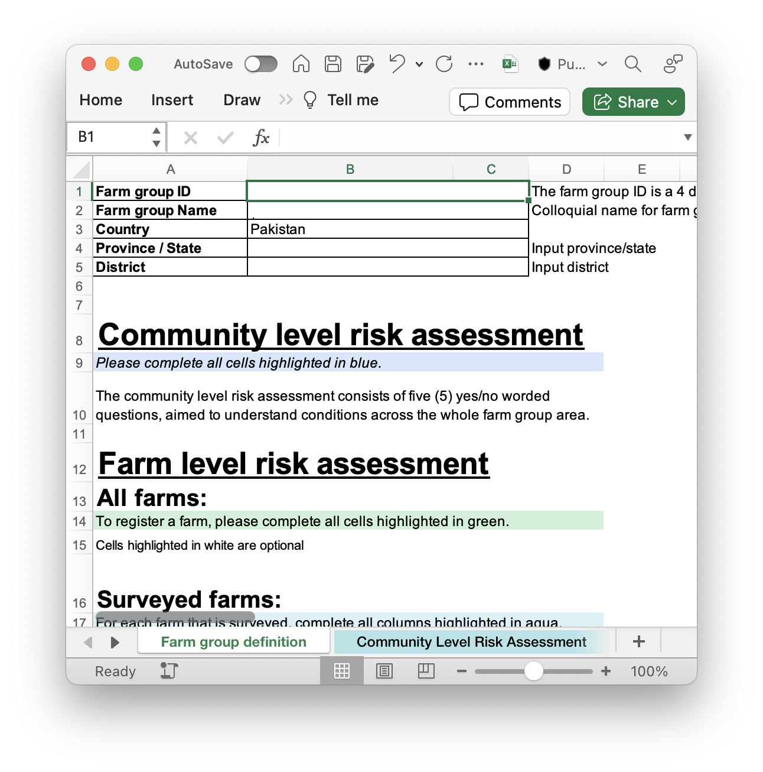
Farm Group Assessment
Excel file will be provided by Global Trace
Farm group definition
Community Level Risk Assessment
Identify factors that are common across a community
Access to schooling & feeding programs
Availability of casual adult labor force
Network connectivity in community
OSH Incidents reported at local clinics

Slide 5
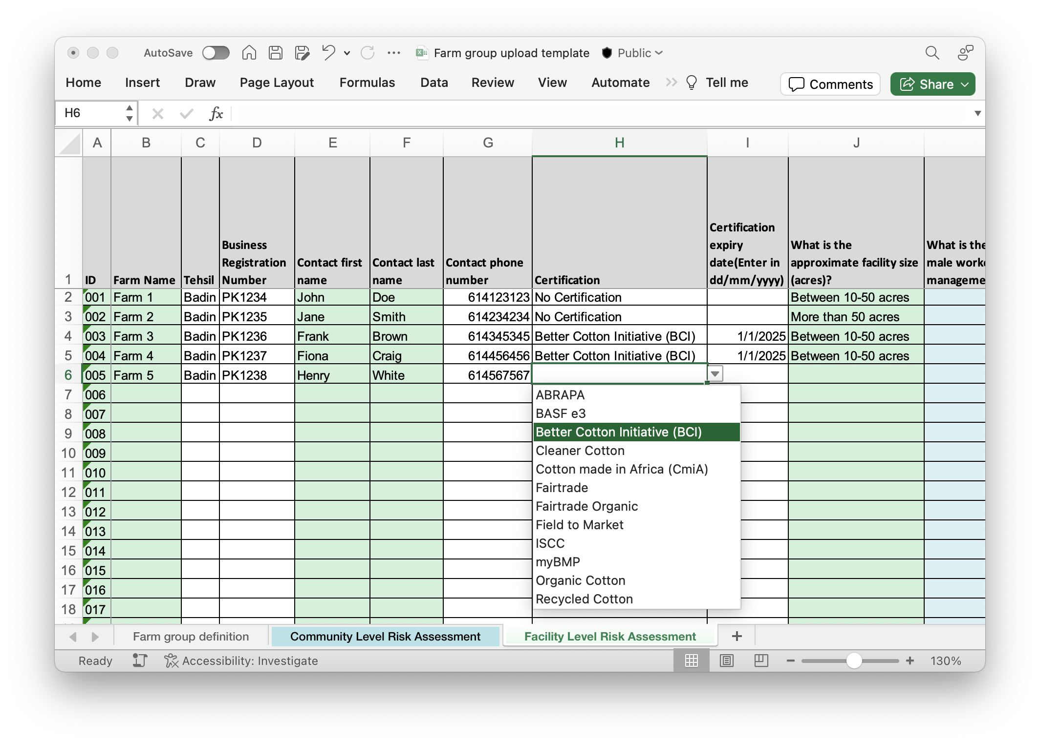
Facility Assessment
One line per farm
Use dropdowns (where provided)
Conditions averaged across farm group
When completed, return to Global Trace team to upload

Slide 6
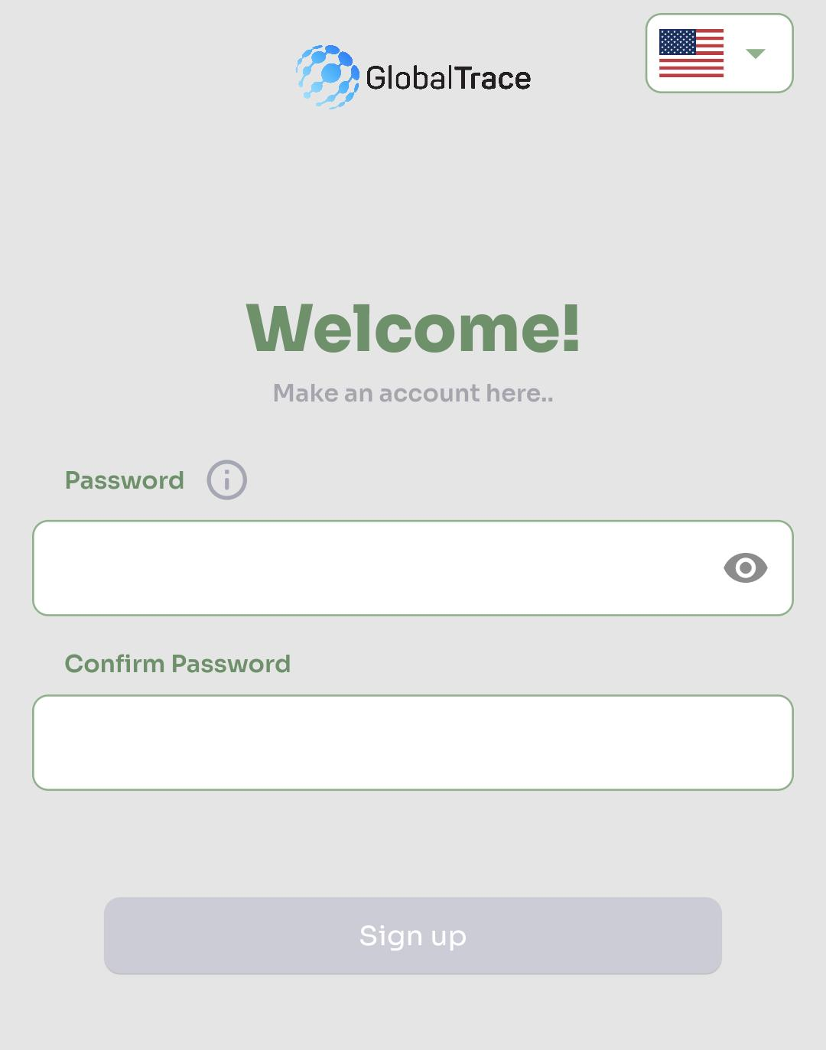
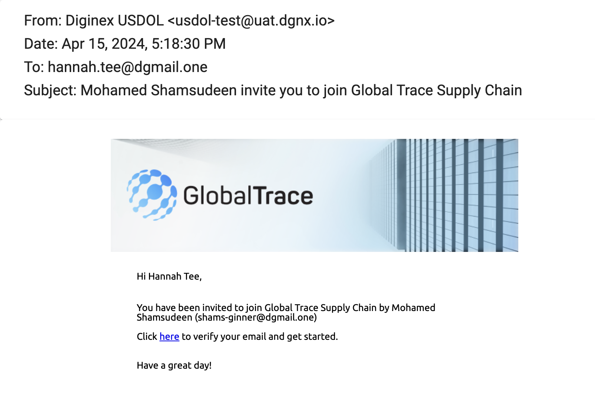
Creating your Account
On receipt of the invitation from GT, please click the link
Set your password
Follow the guidelines on how to create a strong password
On successful sign-up, you will land on the onboarding screen

Slide 7
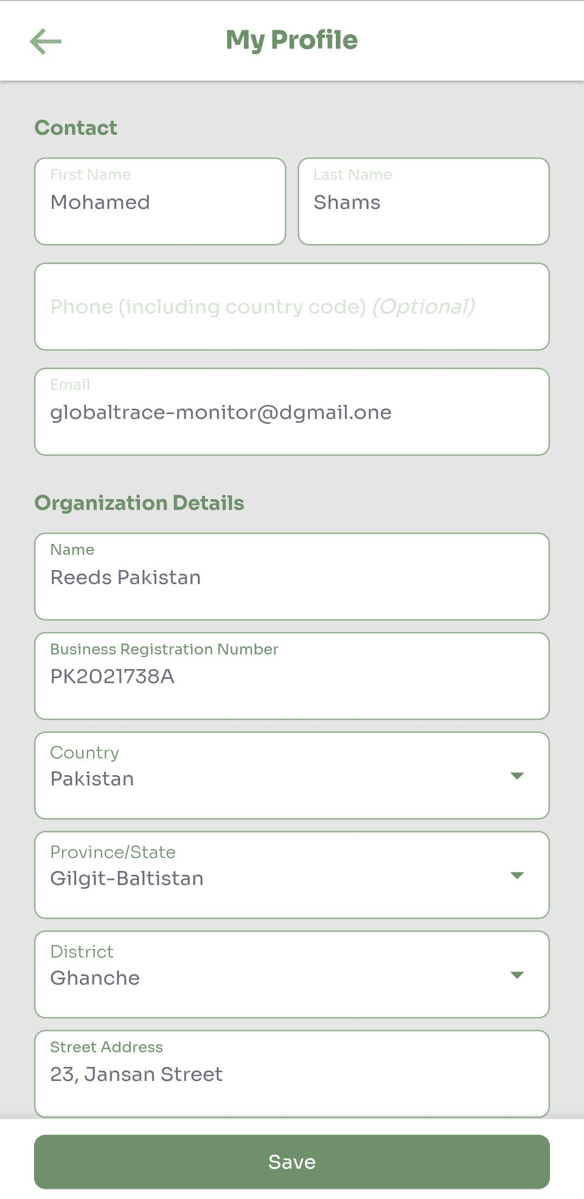
Complete Onboarding(Profile)
First/Last Name auto-populated from the GTP’s invitation request, but can be updated
Business Name – Legal name of entity
Address of this entity
Optional: Phone number

Slide 8
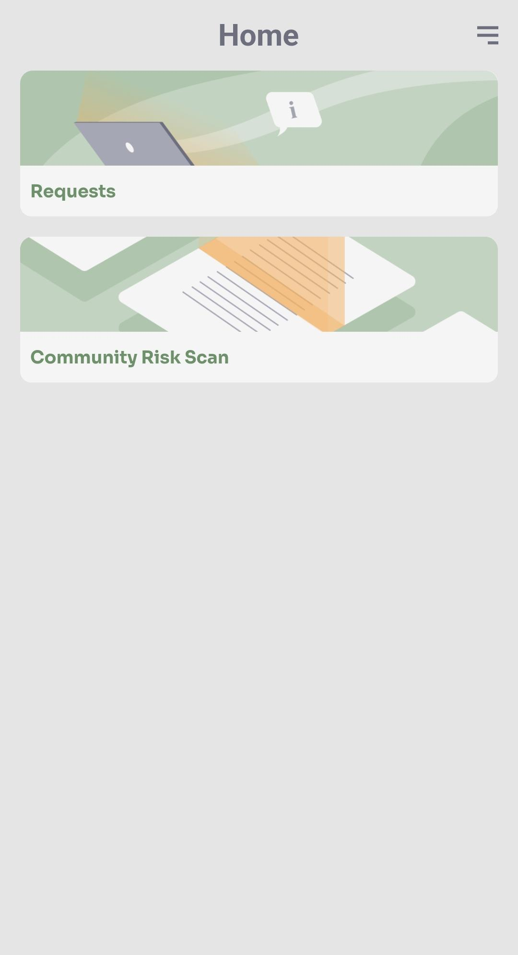
Home Screen
Displays tool-tips during first login
Requests
Reactively respond to incident for information about a specific area or event
Community risk scan
Proactive assessment performed by CSO, allowing to report any issue they have identified

Slide 9
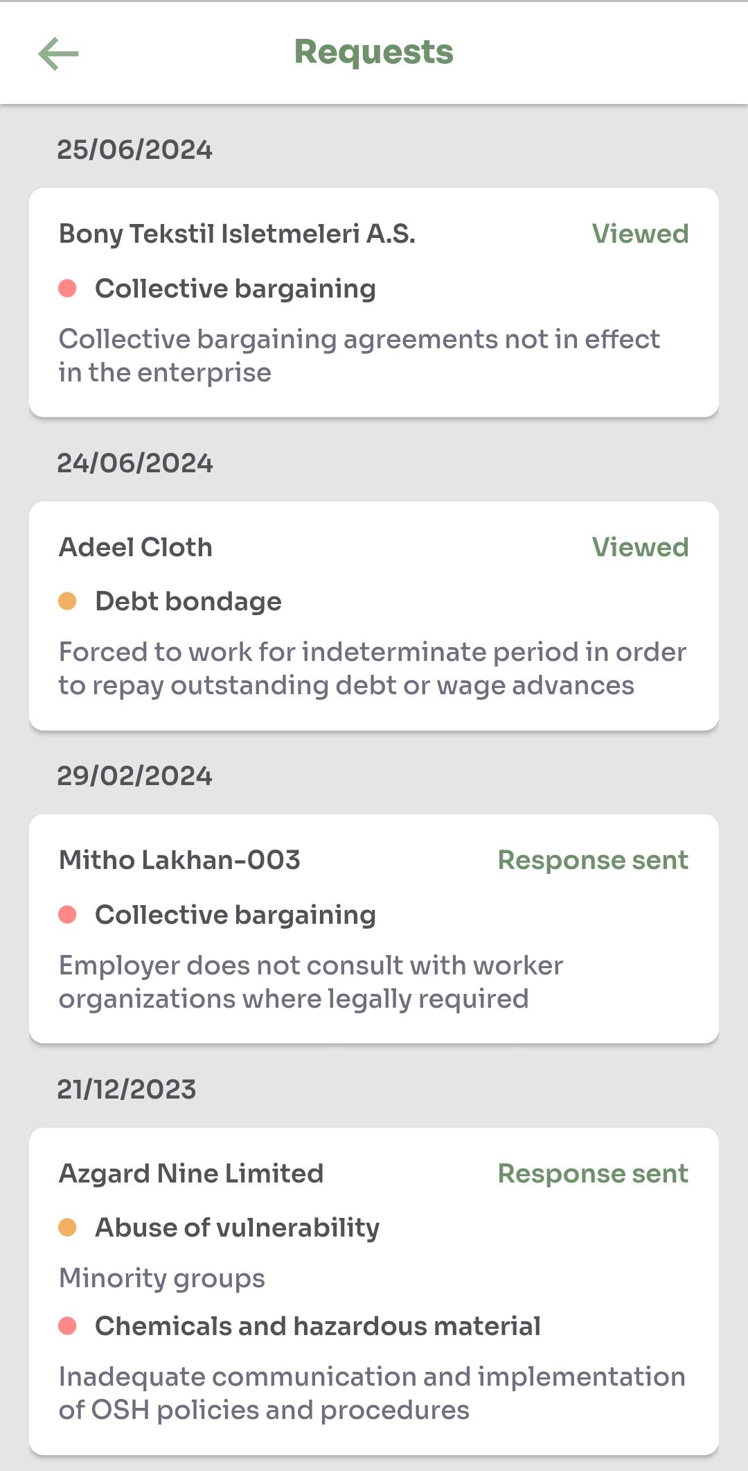
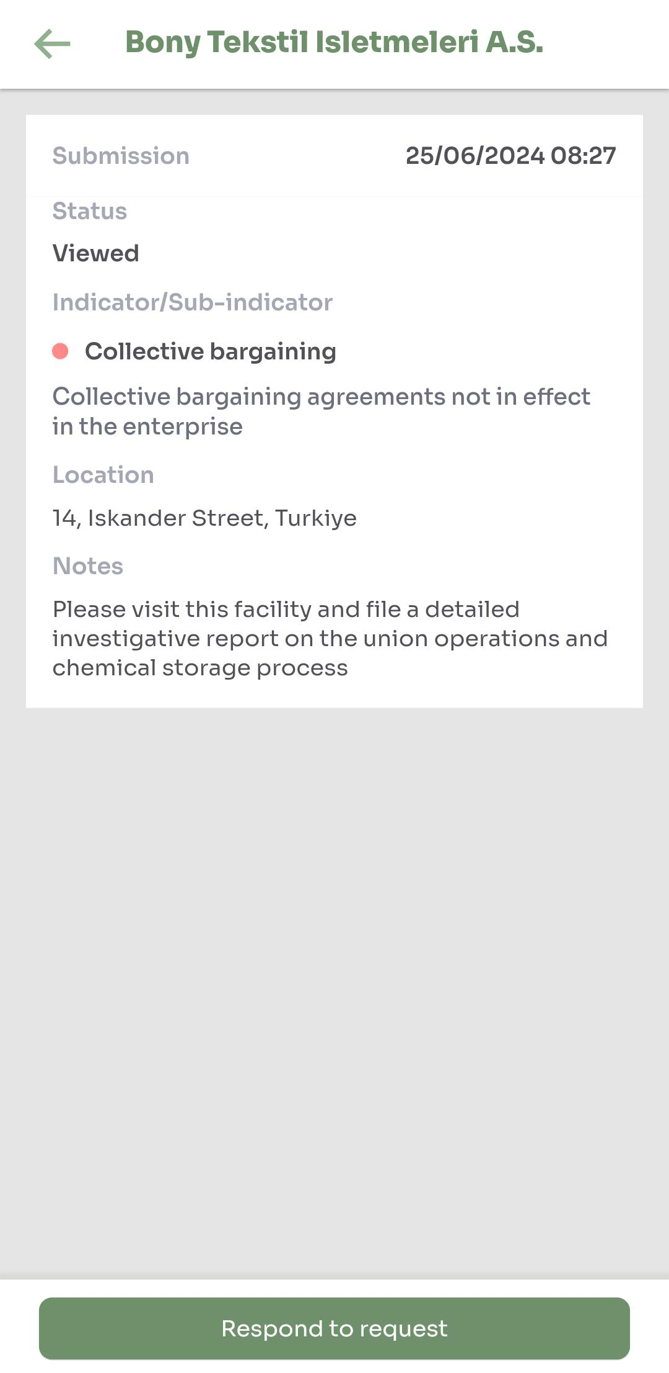
Requests
Summary of all incident requests assigned to the labor partners
Each message show communication thread between grievance unit and user
Request summary
Date assigned
Status – New/Viewed/Response sent
New – Unread incident report
Response sent – Read & responded by the labor partner

Slide 10
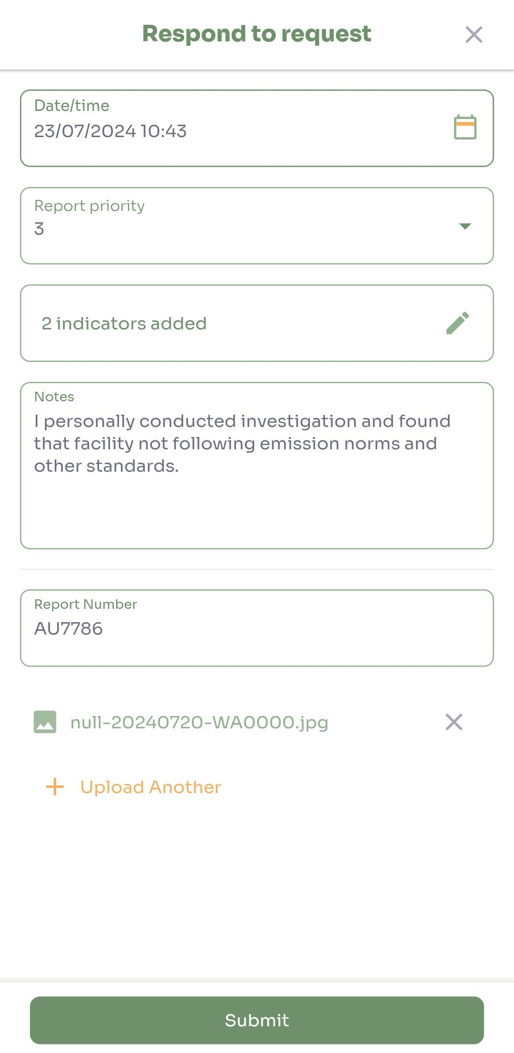
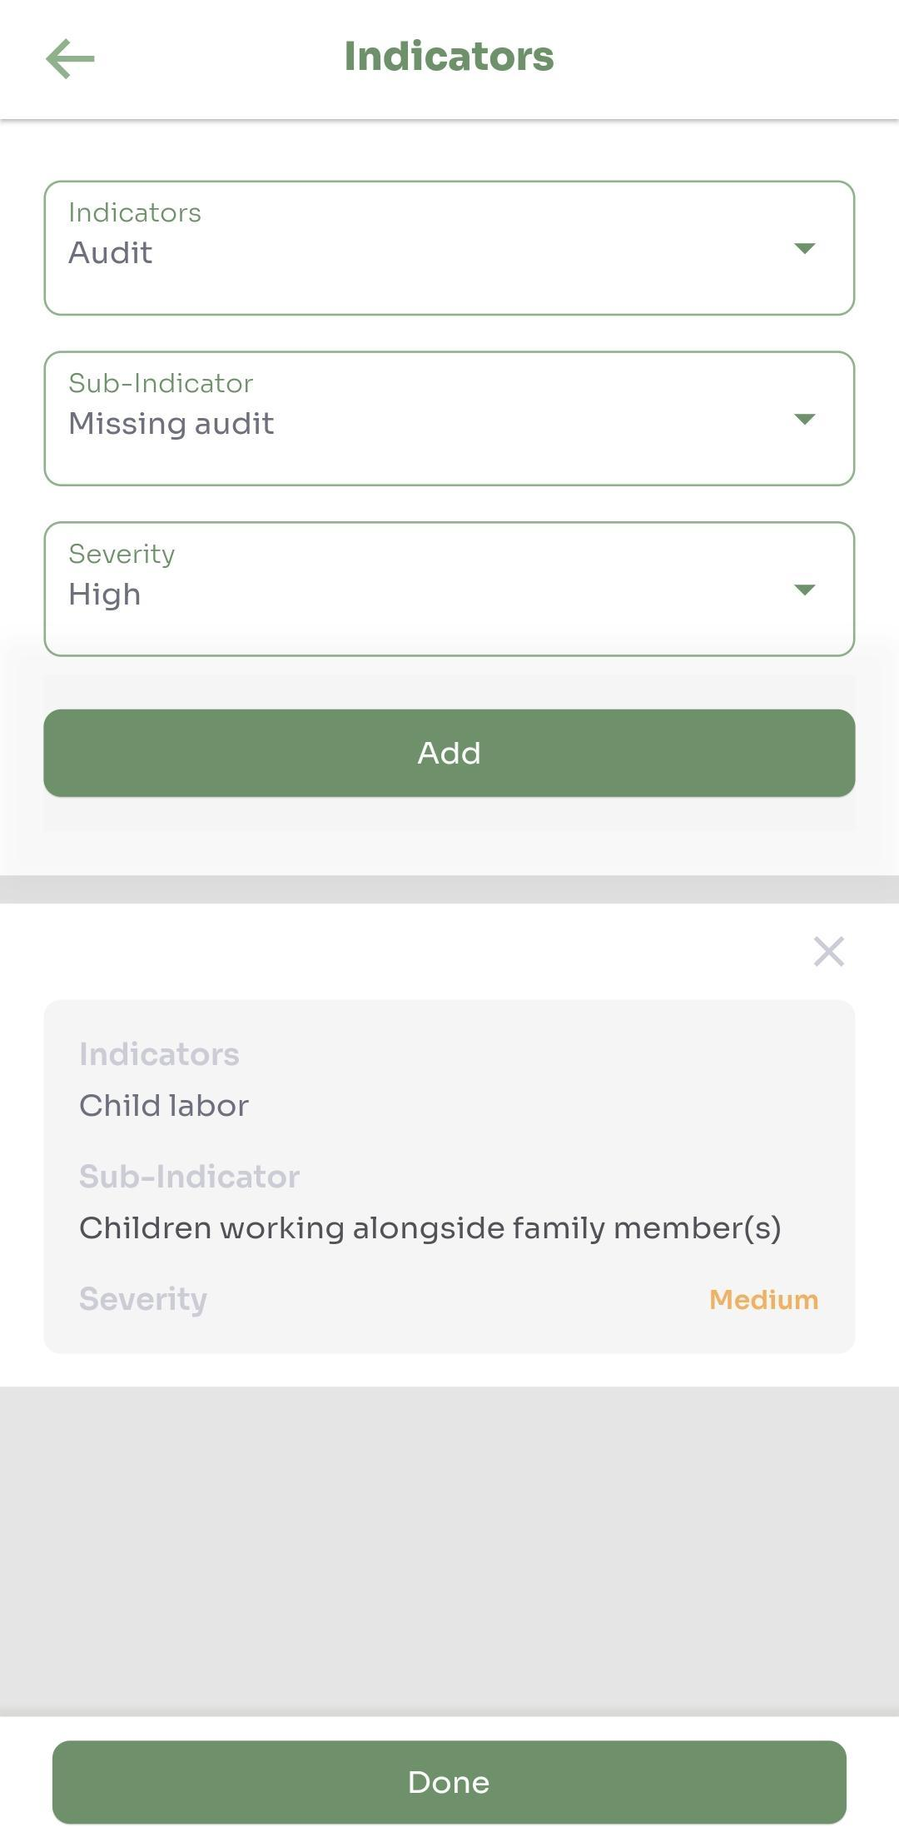
Respond to Request
Provide response to assigned incident
Date / time of response
Report priority
Forced/Child labor indicators
Severity of response
Notes – record your observation
Optional: Report Number
Optional: Attachment can be uploaded from device or you can take a photo using the camera app

Slide 11
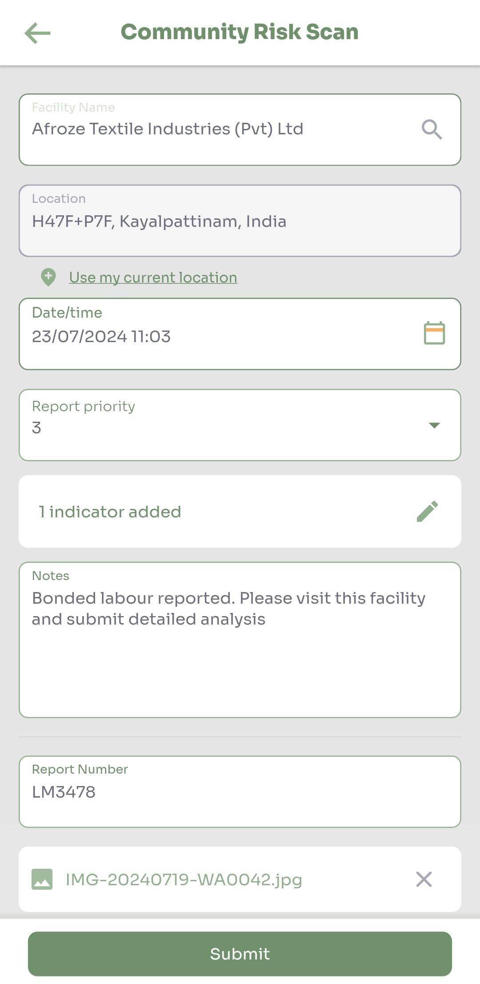
Community Risk Scan
Proactively submits incident reports
Facility
Location – Facility address, or current GPS location
Date / time of submission
Report priority
Forced/Child labor indicators
Severity of response
Notes – record your observation
Optional: Report Number
Optional: Attachment can be uploaded from device or you can take a photo using the camera app

Slide 12
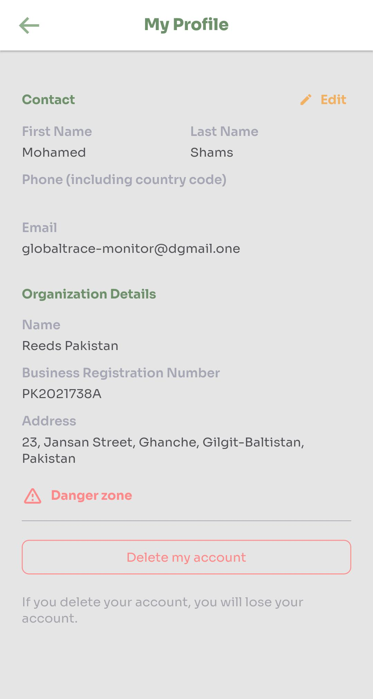
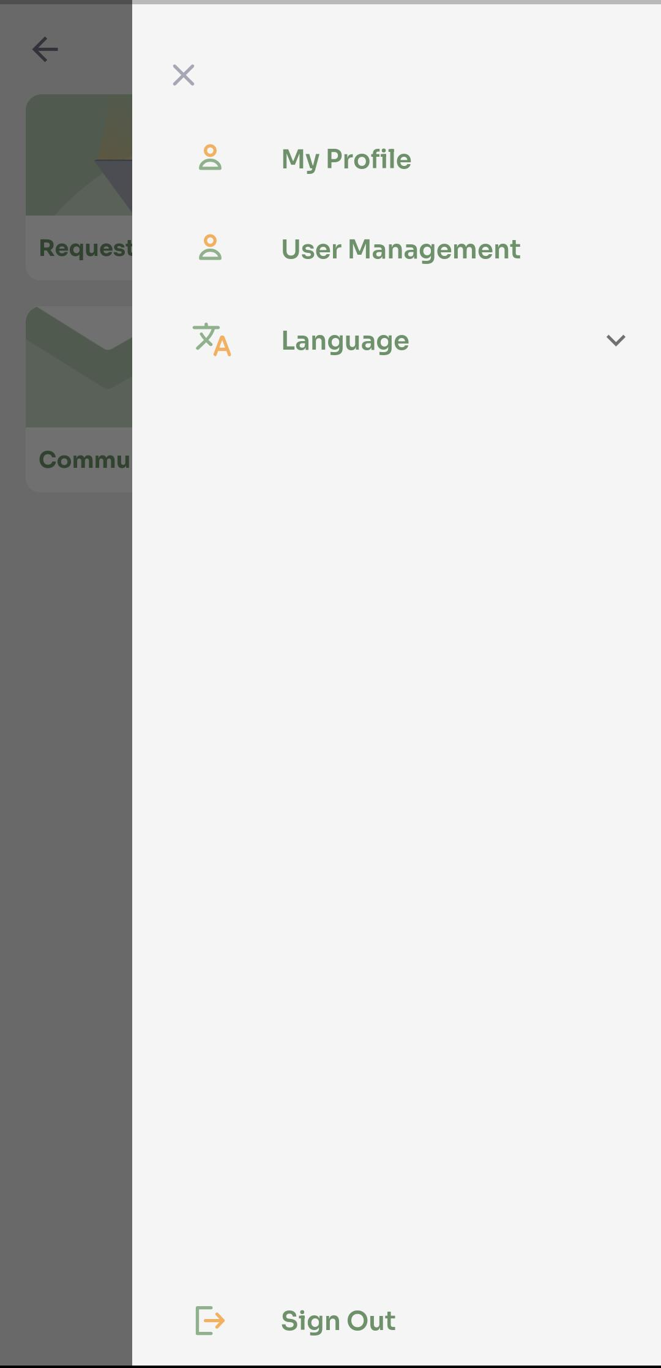
Side Menu – Edit Profile, Delete own account, Log out
Enables farm monitor to edit details set during onboarding
User can delete their own account: if the account is deleted, all data​ will be lost

Slide 13
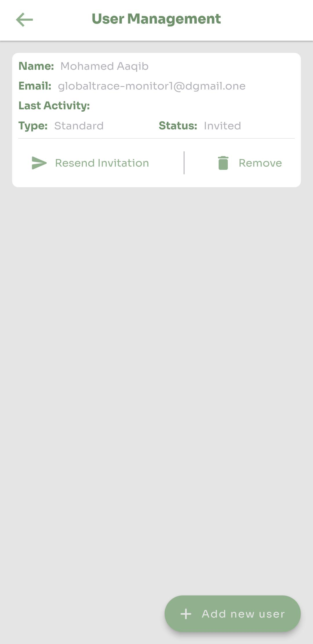
Side Menu: User Management
Organization admin can invite multiple users as Standard/Admin​
Can deactivate and delete users​

Slide 14
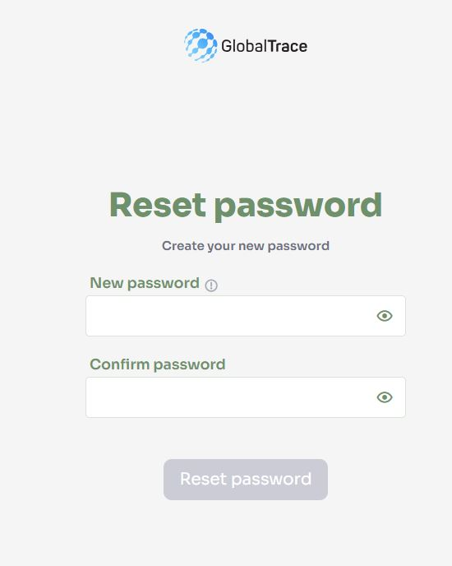
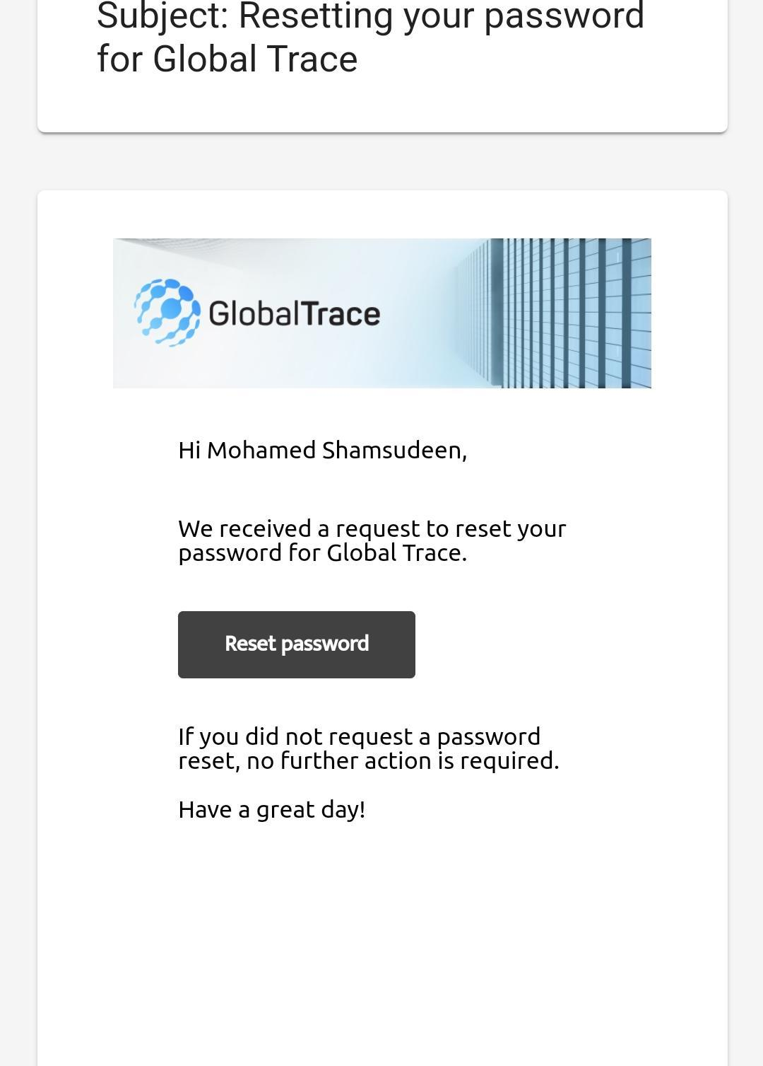
Forgot Password
If you forget your password, use ‘Forgot Password’ link on login page
Email sent to registered address
Click on link in email to reset your password

Slide 15

Funding is provided by the United States (U.S.) Department of Labor (DOL) under cooperative agreement number IL-35808-20-75-K. One hundred percent of the total costs of the project or program is financed with USG federal funds, for a total of $4 million dollars. This material does not necessarily reflect the views or policies of the United States Department of Labor, nor does mention of trade names, commercial products, or organizations imply endorsement by the United States Government.

Slide 16
Farm Monitor User Manual
THANK YOU
Implemented by ELEVATE Ltd.
Funded by the Bureau of International Labor Affairs, USDOL IL358082075K

